Slide 1

Methods for Causal Inference in Educational Research
January/February 2022
Isa Steinmann

Slide 2
Take-away messages
!
DD can be applied if different development between treatment and control group and common trends in absence of treatment
In this case, ceteris paribus can be assumed
Common trends assumption should be theoretically and, if possible, empirically be justified
DD requires repeated cross-sectional or longitudinal panel data

Slide 3
9 | Regression Discontinuity Designs II Time: 14 February 2022, 12:15-14:00h Main instructor: Isa Steinmann Required reading: Luyten (2006)
10 | Differences-in-Differences Designs I Time: 17 February 2022, 12:15-14:00h Main instructor: Isa Steinmann Required reading: Angrist & Pischke (2015), chapter 5
11 | Differences-in-Differences Designs II Time: 21 February 2022, 12:15-14:00h Main instructor: Isa Steinmann Required reading: Strello, Strietholt, Steinmann, & Siepmann (2021)
12 | Lessons Learned and Closing Time: 23 February 2022, 12:15-14:00h Main instructor: Isa Steinmann Required reading: Rutkowski & Delandshere (2016)
9 | Regression Discontinuity Designs II Time: 14 February 2022, 12:15-14:00h Main instructor: Isa Steinmann Required reading: Luyten (2006)
10 | Differences-in-Differences Designs I Time: 17 February 2022, 12:15-14:00h Main instructor: Isa Steinmann Required reading: Angrist & Pischke (2015), chapter 5
11 | Differences-in-Differences Designs II Time: 21 February 2022, 12:15-14:00h Main instructor: Isa Steinmann Required reading: Strello, Strietholt, Steinmann, & Siepmann (2021)
12 | Lessons Learned and Closing Time: 23 February 2022, 12:15-14:00h Main instructor: Isa Steinmann Required reading: Rutkowski & Delandshere (2016)
9 | Regression Discontinuity Designs II Time: 14 February 2022, 12:15-14:00h Main instructor: Isa Steinmann Required reading: Luyten (2006)
10 | Differences-in-Differences Designs I Time: 17 February 2022, 12:15-14:00h Main instructor: Isa Steinmann Required reading: Angrist & Pischke (2015), chapter 5
11 | Differences-in-Differences Designs II Time: 21 February 2022, 12:15-14:00h Main instructor: Isa Steinmann Required reading: Strello, Strietholt, Steinmann, & Siepmann (2021)
12 | Lessons Learned and Closing Time: 23 February 2022, 12:15-14:00h Main instructor: Isa Steinmann Required reading: Rutkowski & Delandshere (2016)

Slide 4
Overview
Early-tracking example in Strello et al. (2021)
R demonstration

Slide 5
?
What do you remember from Strello et al. (2021)?

Slide 6
Early tracking effects
Early-between school tracking as controversial educational policy
Selection not just based on ability but also social background
Tracked secondary schools differ in quality (unequal curricula, resources,…)
Stigmatization of lower track schools
Lack of transmissibility
…
Strello et al. (2021)

Slide 7
Early tracking effects
Assumed effects on
Achievement level (performance level*)
Achievement inequalities
General variation (dispersion inequality*)
Proportion not reaching minimum level (educational inadequacy*)
Segregation between social groups
SES (see Strello et al., forthcoming)
Gender (see Steinmann et al., under review)
Achievement inequalities between social groups
Gap between students with less than 100 vs. at least 100 books at home (social achievement gap*)
Gender (see Steinmann et al., under review)
* in Strello et al. (2021)

Slide 8
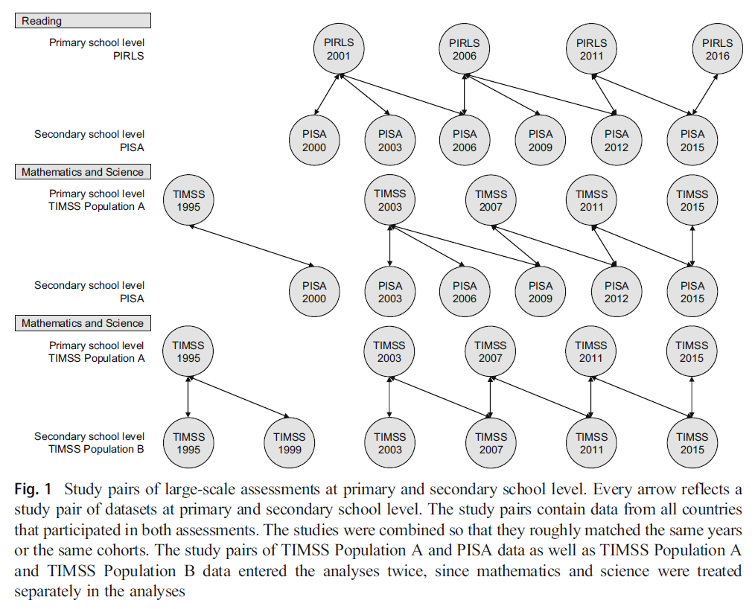
Data in Strello et al. (2021)

Slide 9
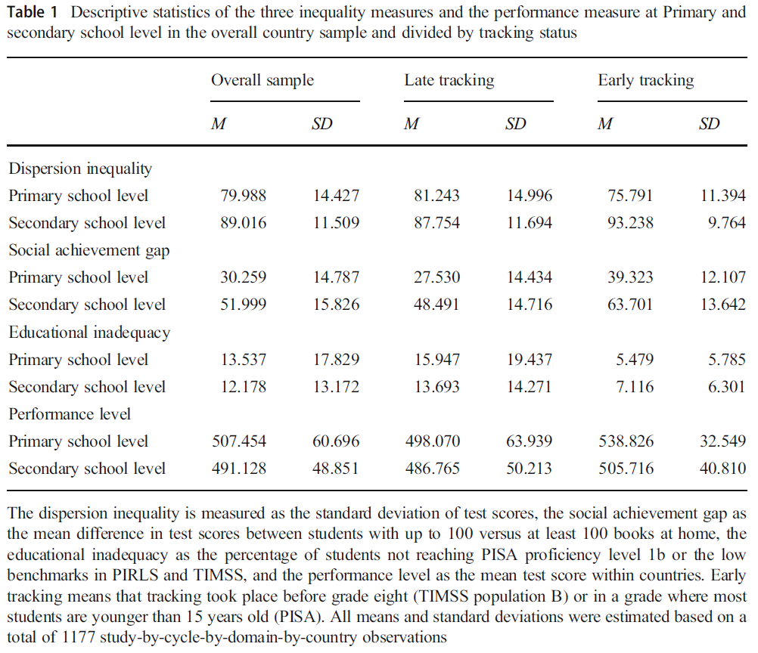
Descriptives in Strello et al. (2021)

Slide 10
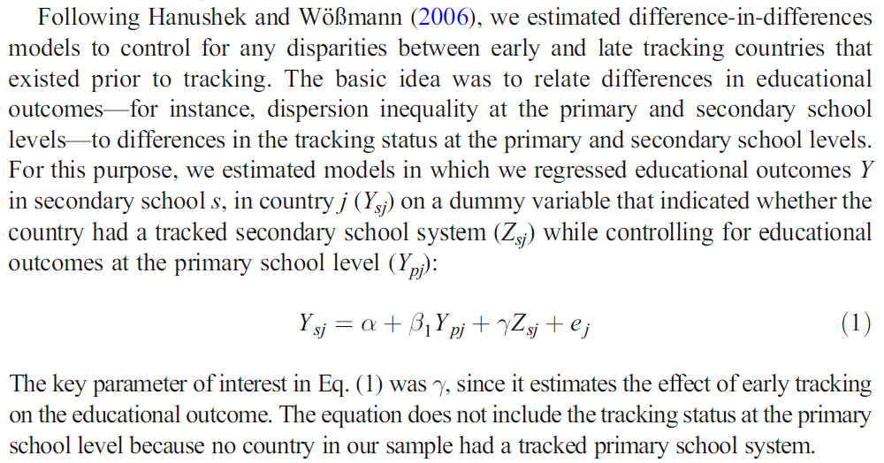
Analyses in Strello et al. (2021)

Slide 11
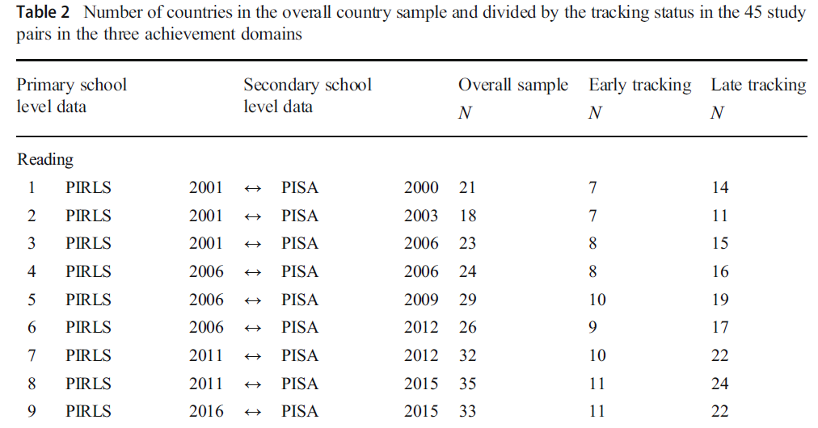
Analyses in Strello et al. (2021)

Slide 12
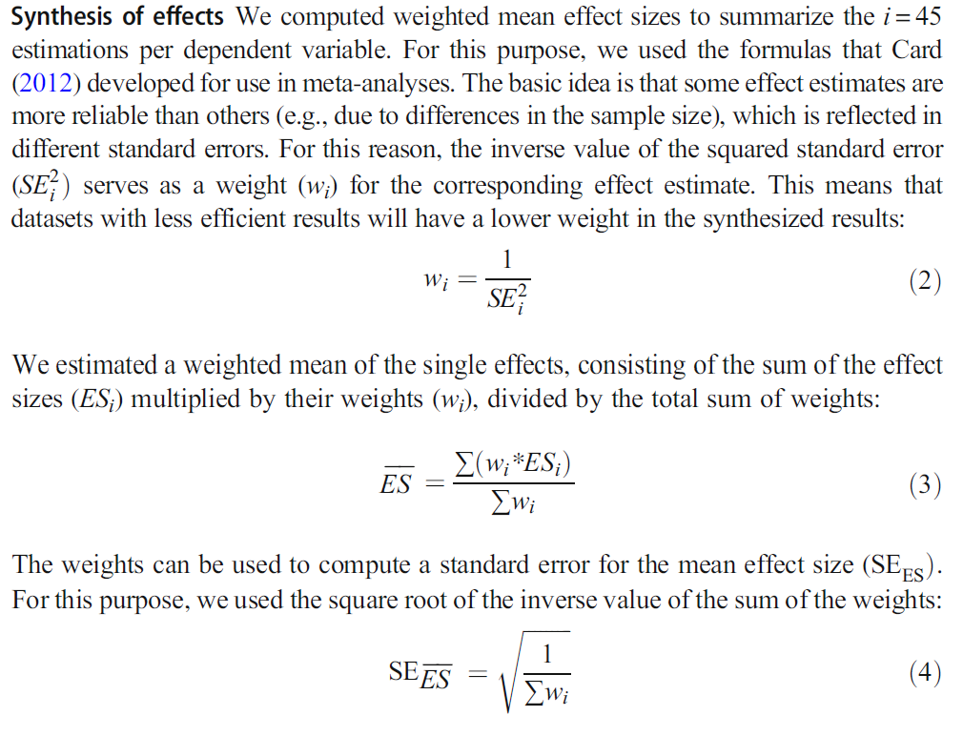
Analyses in Strello et al. (2021)

Slide 13
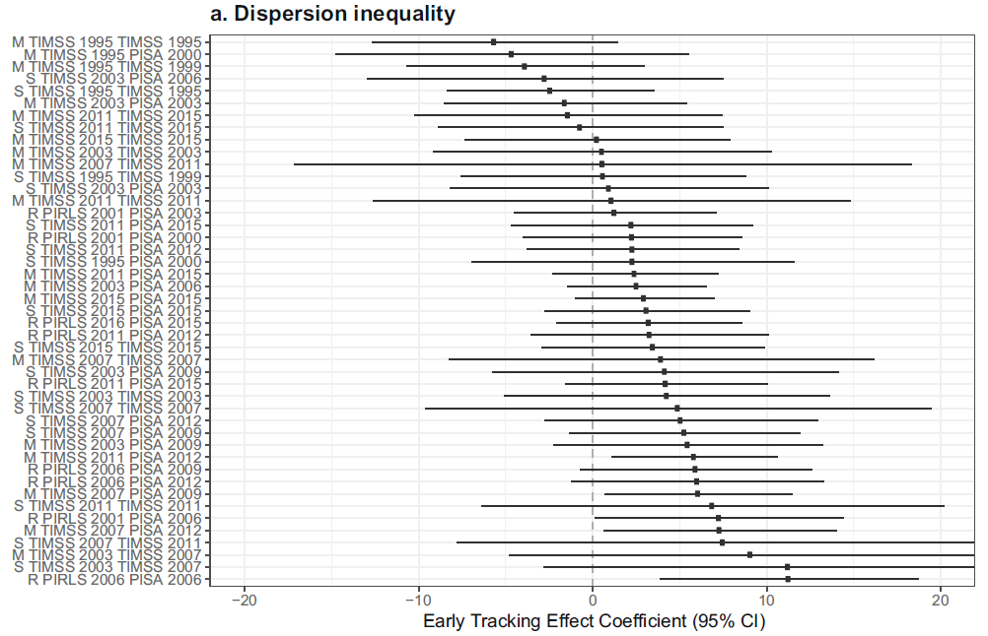
Findings in Strello et al. (2021)

Slide 14
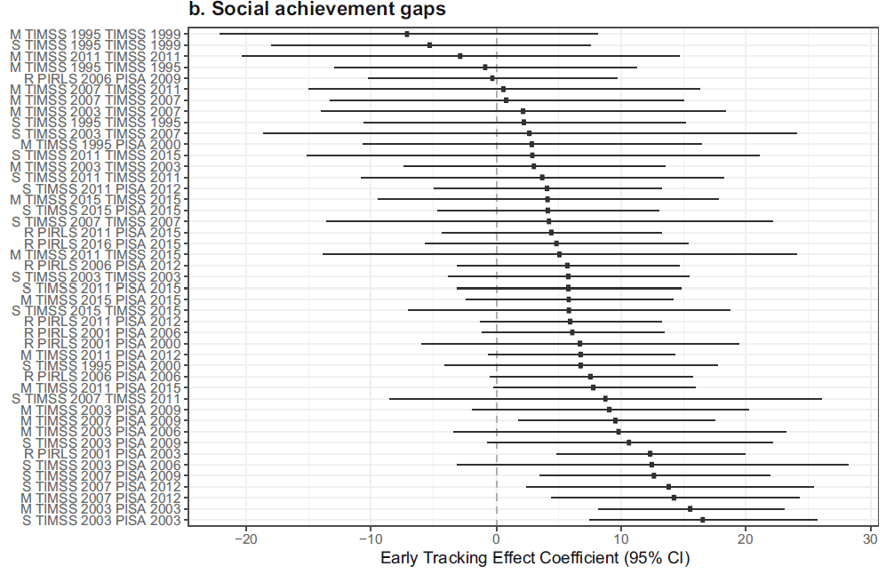
Findings in Strello et al. (2021)

Slide 15
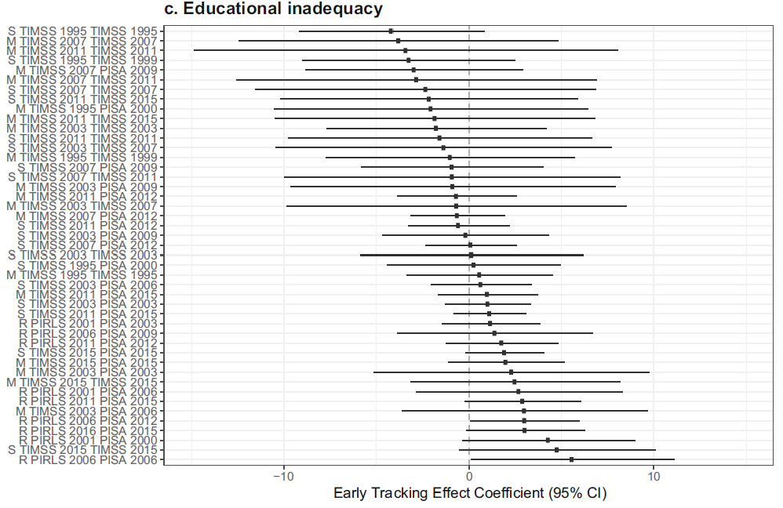
Findings in Strello et al. (2021)

Slide 16
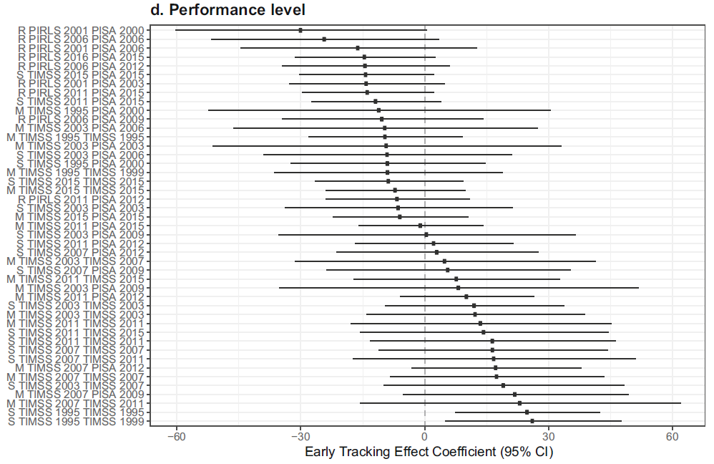
Findings in Strello et al. (2021)

Slide 17
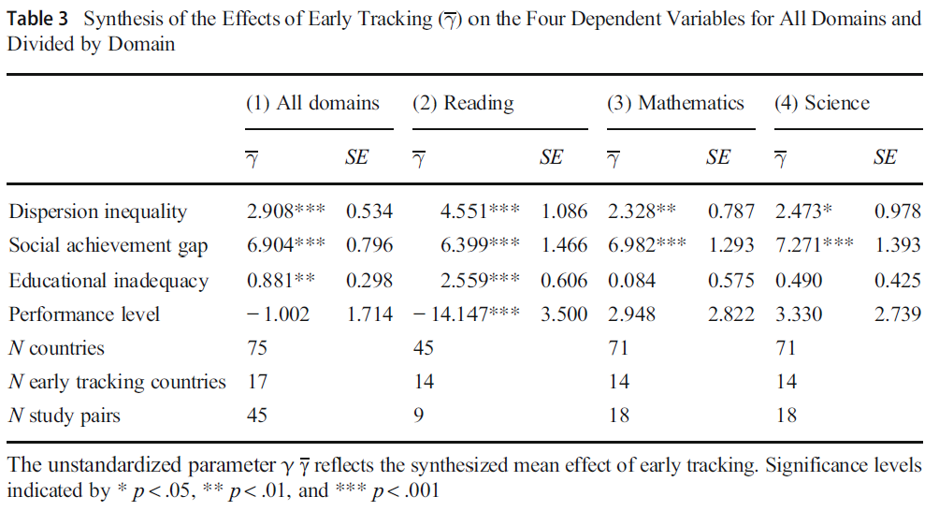
Findings in Strello et al. (2021)

Slide 18
?
Questions so far?

Slide 19
Early tracking effects on gender segregation
Allocation to lower secondary tracks can differ by gender due to
Achievement differences at primary school level
Teacher grade differences at primary school level
Possible effects on between-school gender segregation have not been investigated so far

Slide 20
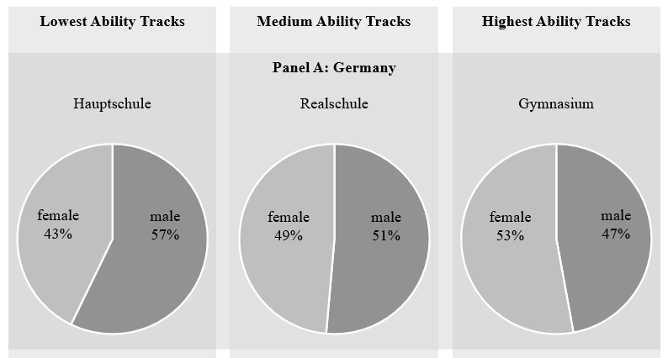
Early tracking effects on gender segregation
Allocation to lower secondary tracks can differ by gender due to
Achievement differences at primary school level
Teacher grade differences at primary school level
Possible effects on between-school gender segregation have not been investigated so far
Own illustration based on data from Destatis https://www.destatis.de/DE/Themen/Gesellschaft-Umwelt/Bildung-Forschung-Kultur/Schulen/_inhalt.html

Slide 21
Data in Steinmann et al. (under review)
* Focus OECD countries

Slide 22
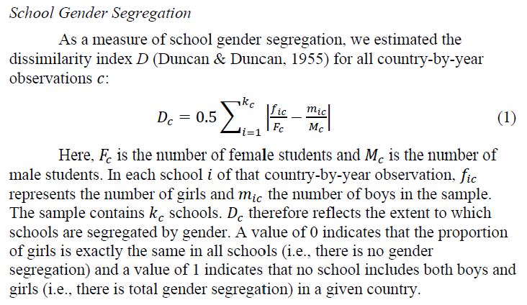
Outcome in Steinmann et al. (under review)

Slide 23
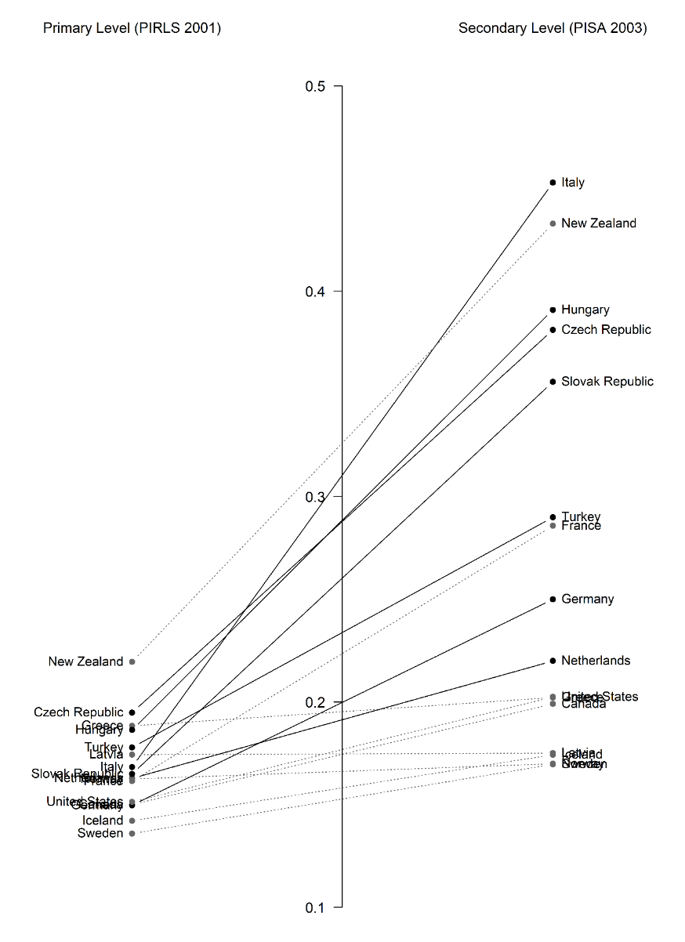
Illustration segregation effect in Steinmann et al. (under review)

Slide 24
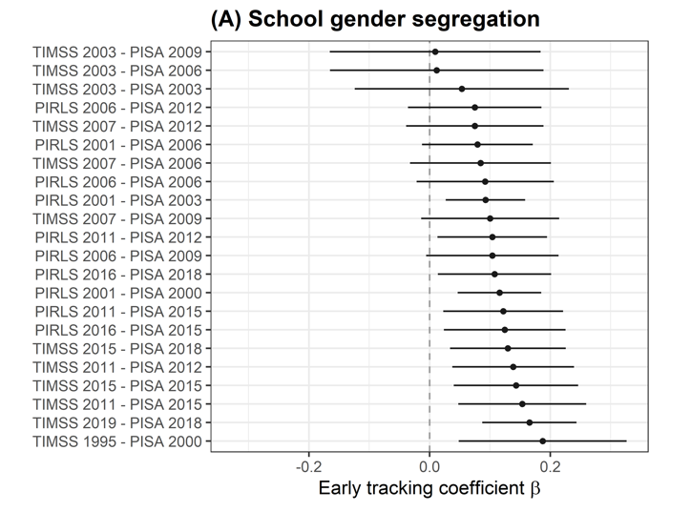
Segregation effect in Steinmann et al. (under review)

Slide 25
?
Questions?

Slide 26
R demonstration
…
See
CausalInference_Session11_Material1.R
GenderSegregation.RData

Slide 27
?
What are central limitations of these studies?

Slide 28
?
Questions?

Slide 29
Take-away messages
!
DD can be applied to cross-sectional, country-level data, but analyses should be replicated across all cycles
Achilles' heel of studies with only two measurement points is common trends assumption, since it cannot be empirically substantiated

Slide 30
9 | Regression Discontinuity Designs II Time: 14 February 2022, 12:15-14:00h Main instructor: Isa Steinmann Required reading: Luyten (2006)
10 | Differences-in-Differences Designs I Time: 17 February 2022, 12:15-14:00h Main instructor: Isa Steinmann Required reading: Angrist & Pischke (2015), chapter 5
11 | Differences-in-Differences Designs II Time: 21 February 2022, 12:15-14:00h Main instructor: Isa Steinmann Required reading: Strello, Strietholt, Steinmann, & Siepmann (2021)
12 | Lessons Learned and Closing Time: 23 February 2022, 12:15-14:00h Main instructor: Isa Steinmann Required reading: Rutkowski & Delandshere (2016)
9 | Regression Discontinuity Designs II Time: 14 February 2022, 12:15-14:00h Main instructor: Isa Steinmann Required reading: Luyten (2006)
10 | Differences-in-Differences Designs I Time: 17 February 2022, 12:15-14:00h Main instructor: Isa Steinmann Required reading: Angrist & Pischke (2015), chapter 5
11 | Differences-in-Differences Designs II Time: 21 February 2022, 12:15-14:00h Main instructor: Isa Steinmann Required reading: Strello, Strietholt, Steinmann, & Siepmann (2021)
12 | Lessons Learned and Closing Time: 23 February 2022, 12:15-14:00h Main instructor: Isa Steinmann Required reading: Rutkowski & Delandshere (2016)
9 | Regression Discontinuity Designs II Time: 14 February 2022, 12:15-14:00h Main instructor: Isa Steinmann Required reading: Luyten (2006)
10 | Differences-in-Differences Designs I Time: 17 February 2022, 12:15-14:00h Main instructor: Isa Steinmann Required reading: Angrist & Pischke (2015), chapter 5
11 | Differences-in-Differences Designs II Time: 21 February 2022, 12:15-14:00h Main instructor: Isa Steinmann Required reading: Strello, Strietholt, Steinmann, & Siepmann (2021)
12 | Lessons Learned and Closing Time: 23 February 2022, 12:15-14:00h Main instructor: Isa Steinmann Required reading: Rutkowski & Delandshere (2016)

Slide 31
Thanks for your attention!
Isa Steinmann
isa.steinmann@cemo.uio.no

Slide 32
References
Angrist, J. & Pischke, J.-S. (2015). Mastering `Metrics: The Path from Cause to Effect. Princeton University Press
Steinmann, I., Strello, A., & Strietholt, R. (under review). Early tracking effects on gender segregation and disparities.
Strello, A., Strietholt, R., & Steinmann, I. (forthcoming). Does tracking increase segregation? International evidence on the effects of between-school tracking on social school segregation. Research in Social Stratification and Mobility
Strello, A., Strietholt, R., Steinmann, I., & Siepmann, C. (2021). Early tracking and different types of inequalities in achievement: Difference-in-differences evidence from 20 years of large-scale assessments. Educational Assessment, Evaluation and Accountability, 33. 139–167. https://doi.org/10.1007/s11092-020-09346-4

